Slide 1
SONG DATASET ANALYSIS
USING POWERBI
Presented by khadijat abubakar

Slide 2

Problem statement
This project aim to conduct a comprehensive analysis of you Tube song using power BI
The dataset contains key attributes such as video ID, channel title, title, description, tags, published date,
view count, like count, favorite count, comment count, video duration, video definition, and caption
details. The goal is to utilize Power BI to create insightful visualizations and reports that provide a deeper understanding of YouTube songs' performance, popularity, and user engagement. The analysis aims to uncover trends, preferences, and patterns in the data to aid content creators and stakeholders in optimizing their YouTube song content.

Slide 3

DATASET DESCRIPTION
1. video_id: Unique identifier for each YouTube video.
2. channelTitle: Title of the YouTube channel publishing the song.
3. title: Title of the YouTube song video.
4. description: Description provided for the YouTube song video.
5. tags: Tags associated with the YouTube song video.
6. publishedAt: Date and time when the YouTube song video was published.
7. viewCount: Number of views received by the YouTube song video.
8. likeCount: Number of likes received by the YouTube song video.
9. favoriteCount: Number of times the YouTube song video has been marked as a favorite.
10. commentCount: Number of comments posted on the YouTube song video.
11. duration: Duration of the YouTube song video.
12. definition: Video definition or quality (e.g., HD, SD).

Slide 4
PROJECT OBJECTIVES
1. Data Cleaning and Preparation:
- Clean and preprocess the dataset, handling missing values or outliers.
- Convert relevant columns to appropriate data types.
2. Exploratory Data Analysis (EDA):
- Explore patterns and distributions in view counts, like counts, and comments.
- Identify trends in the popularity and engagement of YouTube song videos.
3. Content and Channel Analysis:
- Analyze the distribution of videos across different channels.
- Identify popular tags and their correlation with view counts.
4. Temporal Trends:
- Explore how YouTube song video metrics vary over time.
- Identify peak publishing times and their impact on engagement.
5. User Engagement Insights:
- Investigate relationships between likes, comments, and views.
- Identify factors influencing user engagement with YouTube song videos.

Slide 5
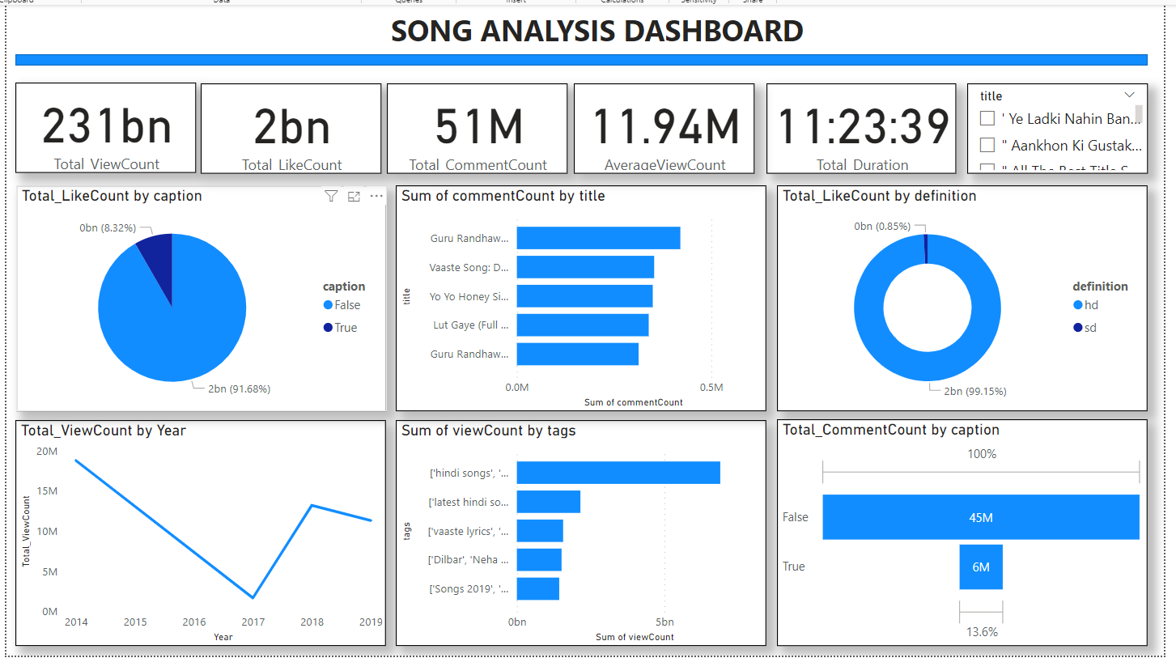
DASHBOARD
DASHBOARD

Slide 6
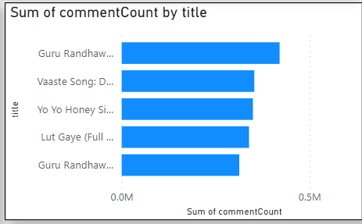
This chart explain the top five title by the sum of commentCount

Slide 7
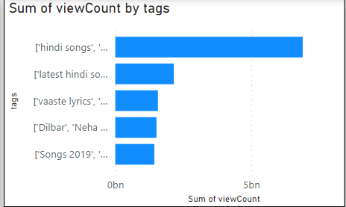
the chart illustrate the top 5 tags by the sum of viewCount

Slide 8
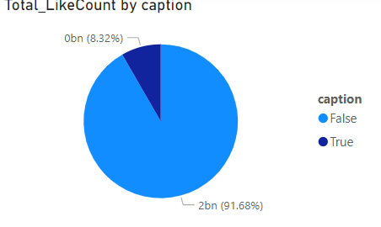
This bar chart explain the total likeCount by the caption

Slide 9
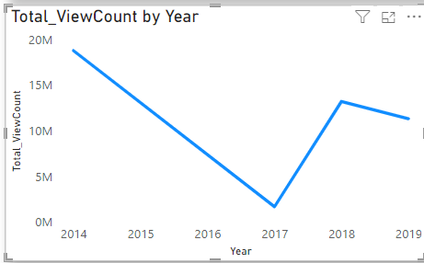
The line chart explain the total viewCount by year

Slide 10
RECOMMENDATION FOR CONTENT CREATORS AND STAKEHOLDER TO ENHANCE YOU TUBE SONG VIDEO PERFORMANCE
Use High-Performing Tags.
Enhance Video Quality.
Content Strategy.
Engagement and Interaction.
Marketing and Promotion.
Audience Insights and Targeting.
Encourage interaction and community building.
Publish at optimal times and maintain a consistent schedule.
High Definition (HD) Content:

Slide 11
THANKS FOR WATCHING

